Slide 1
ERASMUS+ Project
Rmwgr

Slide 2
RECYCLING, SOCIAL AND ECONOMIC ADVANTAGES

Slide 3
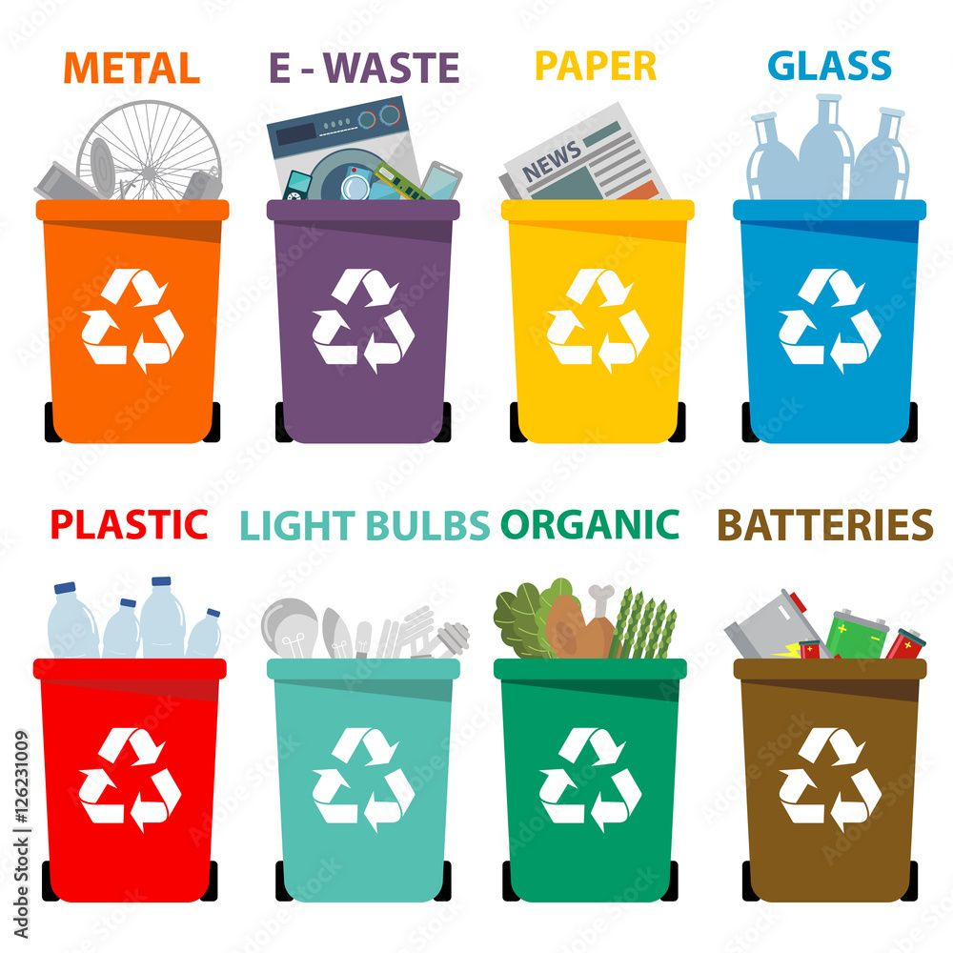
RECYCLING
It focuses on ways to eliminate waste and limit the use of natural resources by reusing, repurposing and for example, a plastic bottle can be transformed into a building or a can made of aluminium can be transformed into a car. Recycling saves non-renewable resources. Moreover, recycling reduces the burden of the environment. As we save energy the number of greenhouse gases and oxides are produced in less quantity. The greatest threat to our planet is the belief that someone else will save it, so each one of us must do everything in their power to make a difference! Change starts with you! Recycle today for a better tomorrow!

Slide 4
SOCIAL ADVANTAGES
Recycling is everyone’s responsibility. As global citizens, we have an obligation to protect the environment for future generations and to ensure that waste is recycled properly. Community recyclers provide work and training opportunities, keep money going around in local economies and make second hand goods available to people. These activities enhance the environment by conserving materials and energy and recovering hazardous products. This helps to engage people in new activities and introduce innovation and new ways of thinking.

Slide 5
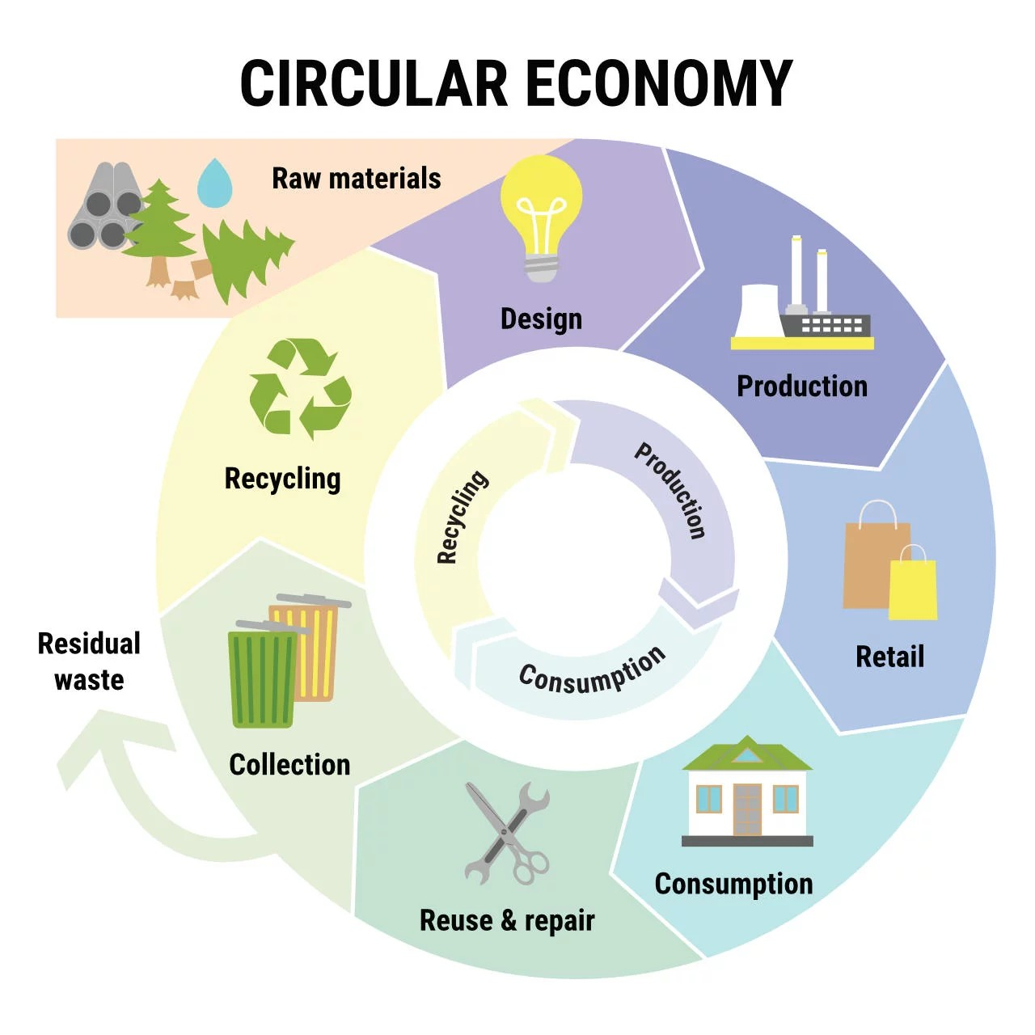
ECONOMIC ADVANTAGES
While the environmental benefits of recycling are well known, what is less known is that recycling is an economic success story as well. By turning waste into valuable raw materials, recycling creates jobs, builds more competitive manufacturing industries and there is absolutely no doubt that recycling materials conserve natural resources, therefore strengthening the economy. Every cost-reduction, energy efficiency, materials conservation and job generation benefit of recycling adds up to help build a strong economy for our country. Recycling, done on a country-wide scale has a huge positive impact on the economy.

